Slide 1


MS SQL PROJECT JOB BOARD HELLO DATA
Zeynep AVCI
İsa YAVUZ
Fırat YORULMAZ

Slide 2
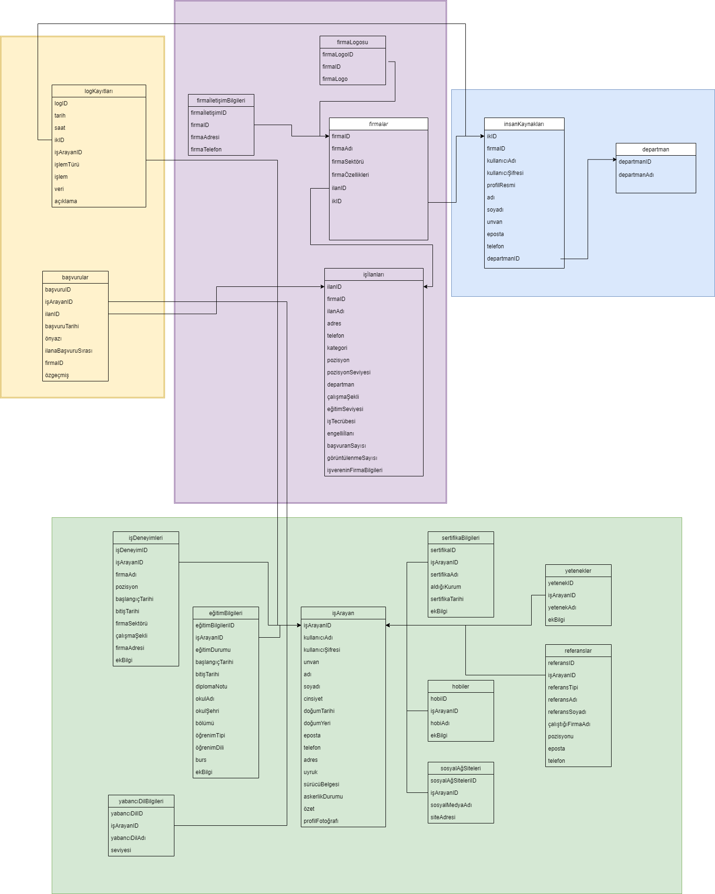
DATA MODEL

Slide 3
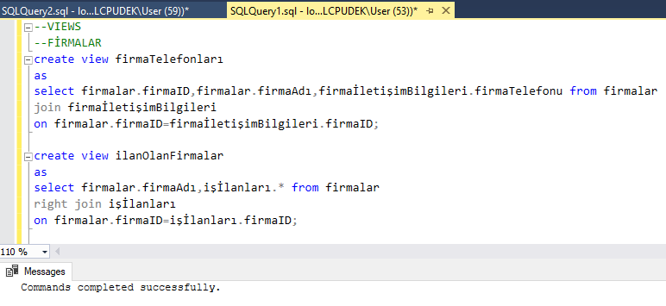
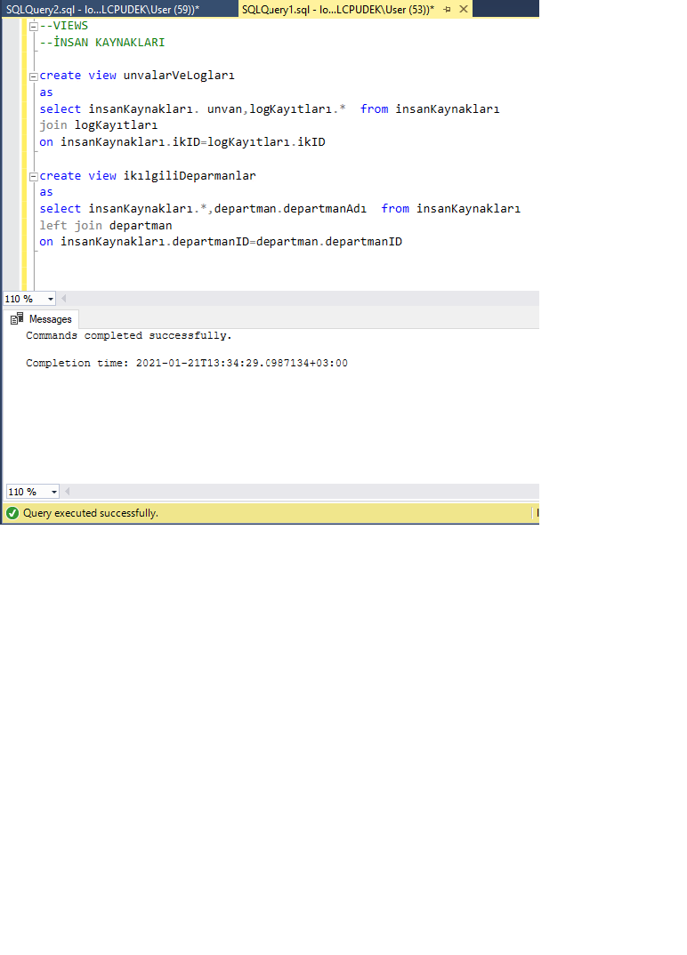
VIEWS

Slide 4
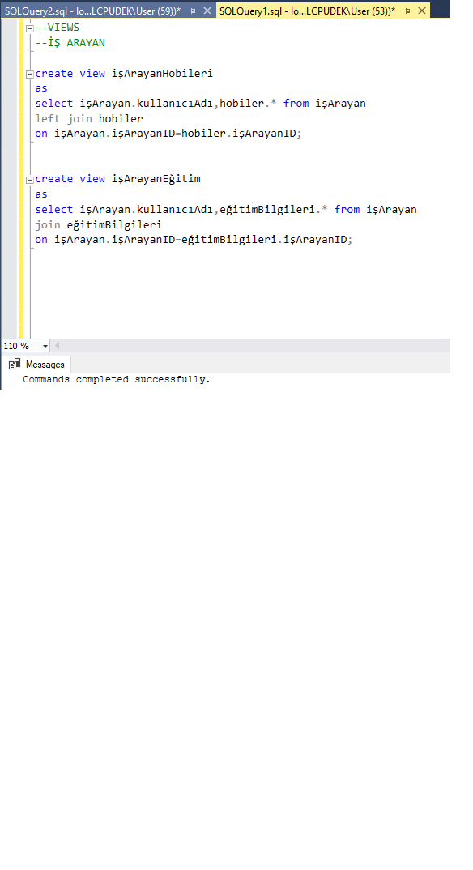
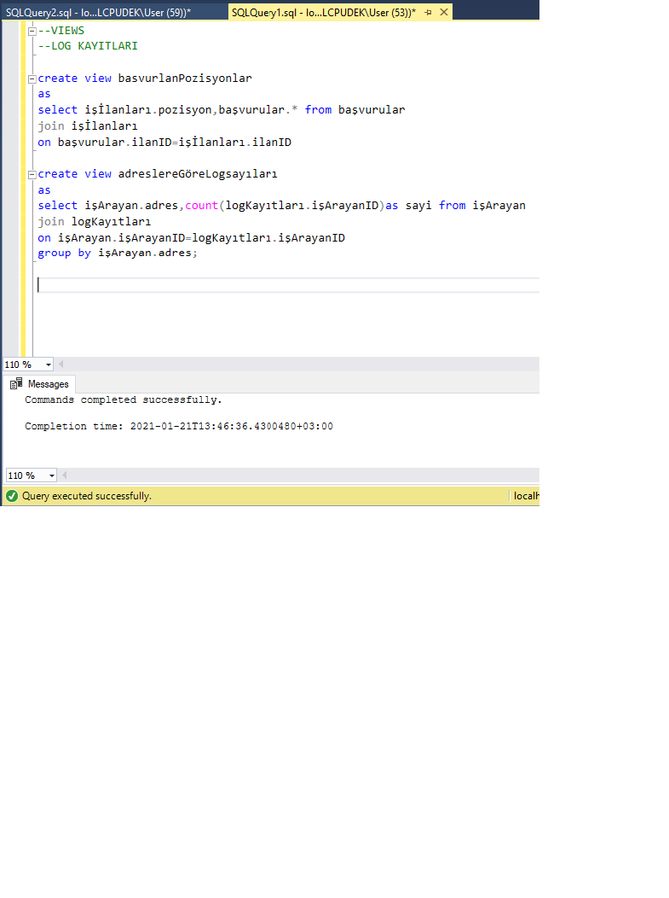
VIEWS

Slide 5
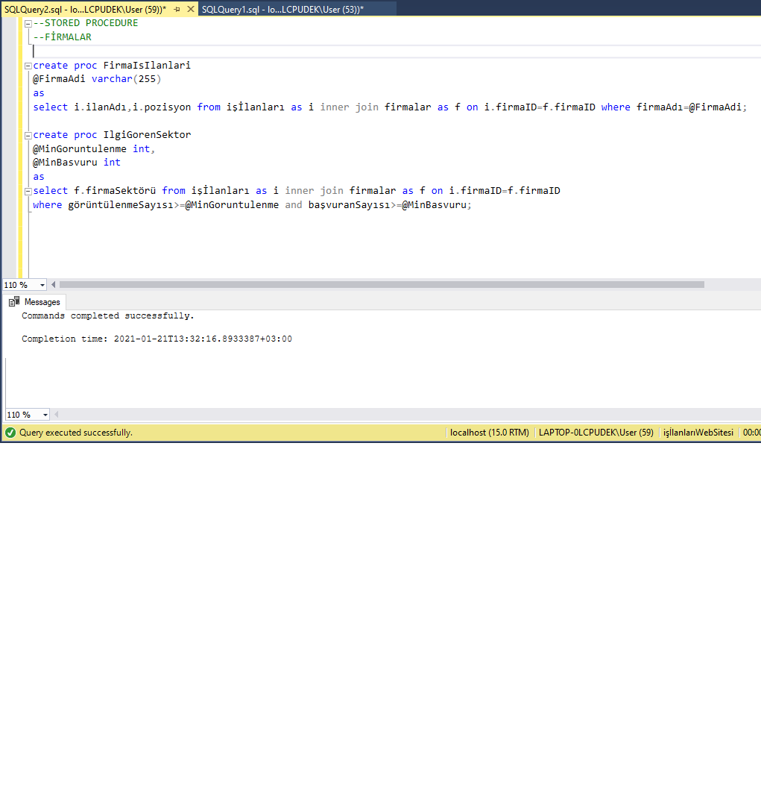
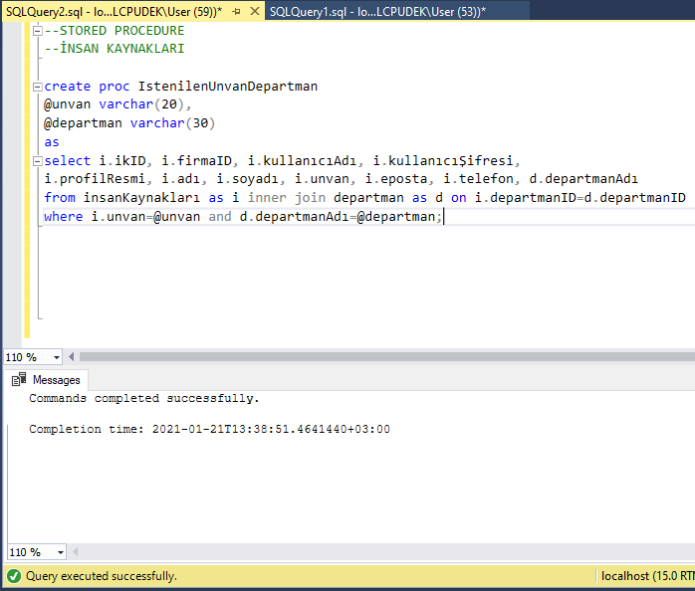
STORED PROCEDURES

Slide 6
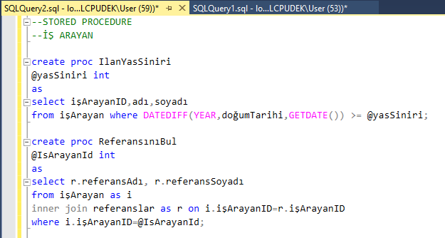
STORED PROCEDURES

Slide 7
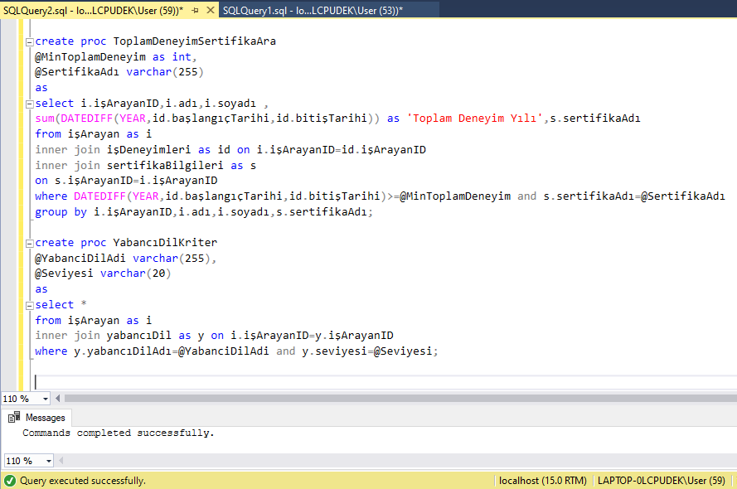
STORED PROCEDURES

Slide 8

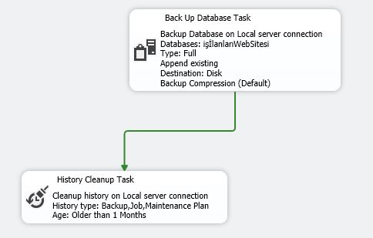
BACKUP STRATEGIES

Slide 9
THANK YOU FOR LISTENING.
HELLO DATA

